Slide 1
Lecture 2 Neural Networks: Introduction & Perceptron
CS582
Machine Learning: Getting Computers
to Program Themselves
“Discovering the Learning Dynamics of the Laws of Nature”
Dr. Emdad Khan
ekhan@miu.edu
Dept. of Computer Science
Maharishi University of Management

Slide 2
Artificial Neural Networks (ANN or just NN)
ANN is a computational model based on the structure and functions of biological neural networks in human brain, the most robust learning systems we know.
We can also say that ANN tries to understand natural biological systems through computational modeling.
Information that flows through the network affects the structure of the ANN because a neural network changes - or learns, in a sense - based on that input and output.

Slide 3
Artificial Neural Networks (ANN or just NN)
Massive parallelism allows for computational efficiency.
Help understand “distributed” nature of neural representations (rather than “localist” representation) that allow robustness and graceful degradation.
Intelligent behavior as an “emergent” property of large number of simple units rather than from explicitly encoded symbolic rules and algorithms.

Slide 4
The Human
Information i/o …
  visual, auditory, haptic (touch), movement
Information stored in memory
  sensory, short-term, long-term
Information processed and applied
  reasoning, problem solving, skill, error
Emotion influences human capabilities
Each person is different

Slide 5
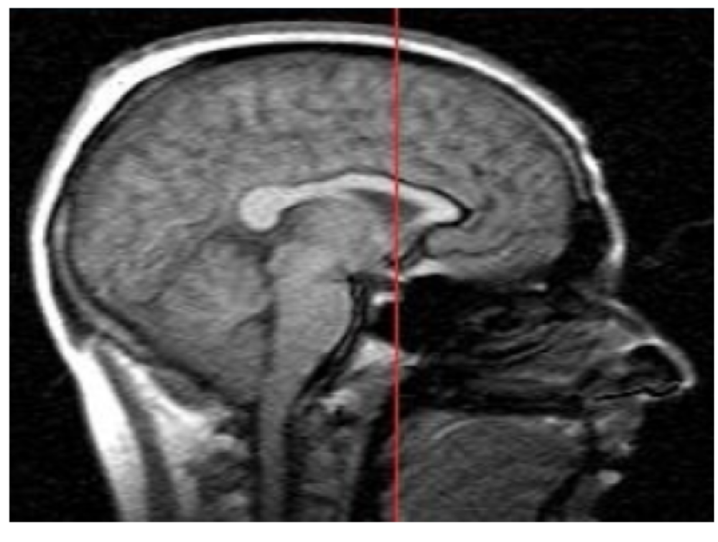
Human Brain

Slide 6
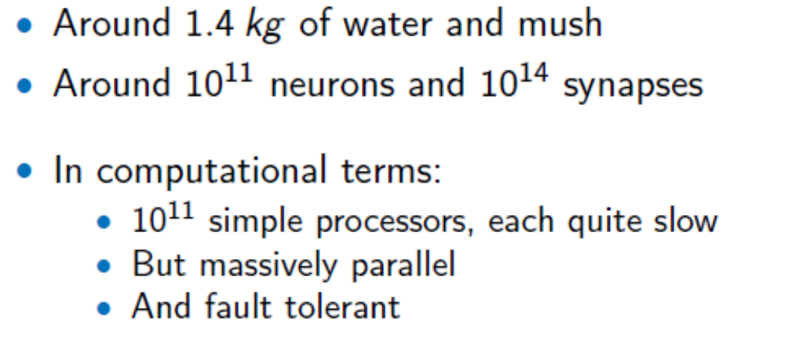
Human Brain

Slide 7
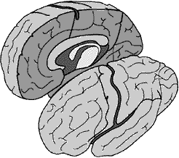
The Human Brain
Brain has 2 Hemispheres
Connected by Corpous
Callosum – a bundle of
nerve fibers.

Slide 8
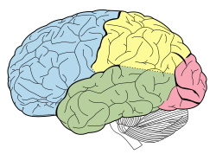
Human Brain Cortices
Red – Occipital lobe
(Vision)
Blue – Frontal Lobe
(attention, short-term
memory tasks, planning)
Green – Temporal Lobe
Auditory, semantics, hippocampus)
Gold – Parietal Lobe
(integrates sensory info.)

Slide 9
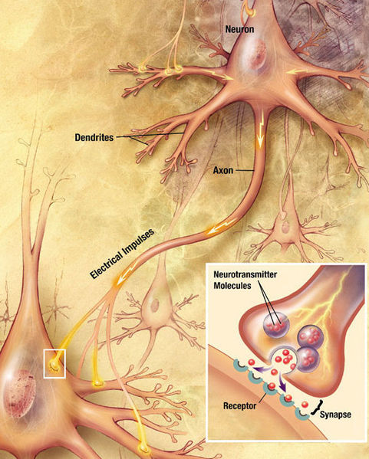
Neurons & Connections

Slide 10
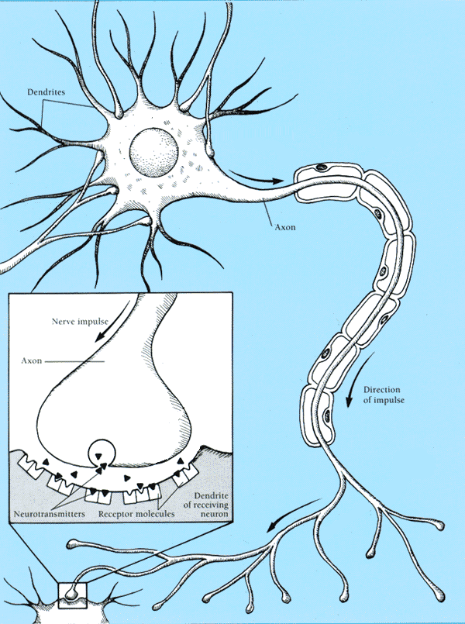
Real Neurons
Cell structures
  Cell body
  Dendrites
  Axon
  Synaptic terminals

Slide 11
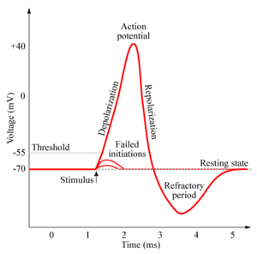
Neural Communication
Electrical potential across cell membrane exhibits spikes called action potentials.
Spike originates in cell body, travels down
axon, and causes synaptic terminals to
release neurotransmitters.
Chemical diffuses across synapse to
dendrites of other neurons.
Neurotransmitters can be excititory or
inhibitory.
If net input of neurotransmitters to a neuron from other neurons is excititory and exceeds some threshold, it fires an action potential.

Slide 12
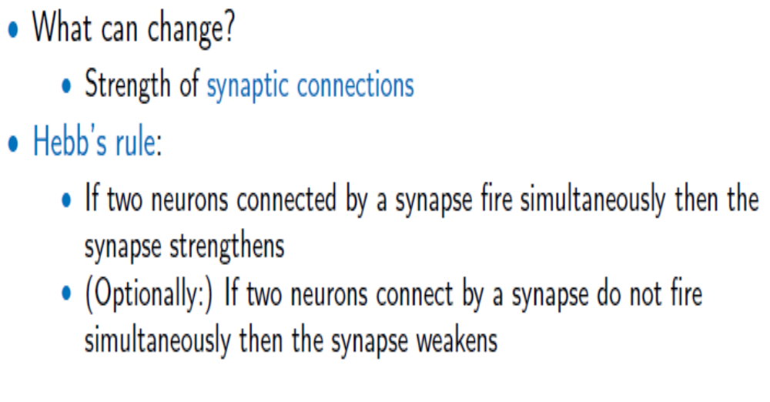
How Does the Brain Learn?

Slide 13
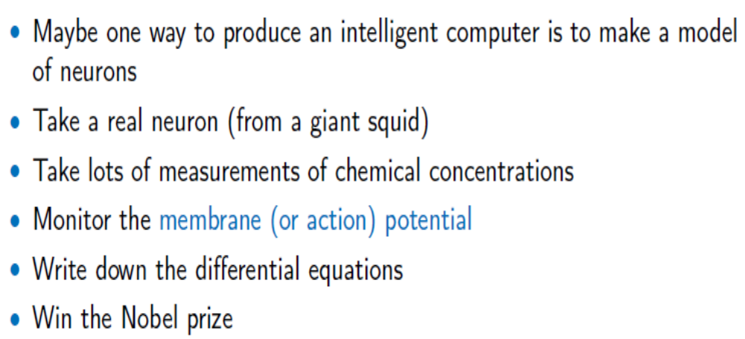
The Hodgkin-Huxley Model

Slide 14
Neural Capabilities & Speed Constraints
Neurons have a “switching time” on the order of a few milliseconds, compared to nanoseconds for current computing hardware.
However, neural systems can perform complex cognitive tasks (vision, speech understanding) in tenths of a second.
Only time for performing 100 serial steps in this time frame, compared to orders of magnitude more for current computers.
Must be exploiting “massive parallelism.”
Human brain has about 10¹¹ neurons with an average of 10⁴ connections each.

Slide 15
ANN – Key Notes
A Very Popular and Mostly Used ML Approach.
There is a Large Gap between ANN and Biological / Real Neuron (More later)

Slide 16
Artificial Neural Network Learning
Learning approach based on modeling adaptation in biological neural systems.
Perceptron: Initial algorithm for learning simple neural networks (single layer) developed in the 1950’s.
Backpropagation: More complex algorithm for learning multi-layer neural networks developed in the 1980’s.

Slide 17
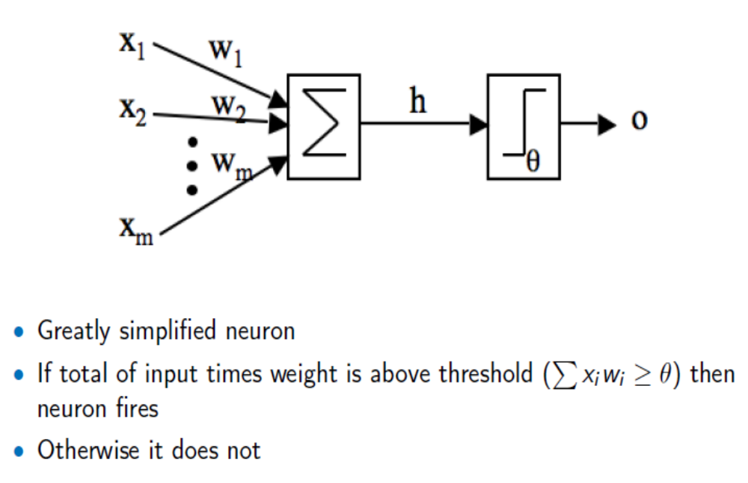
First Artificial Neuron: McCulloch-Pitts Neuron

Slide 18
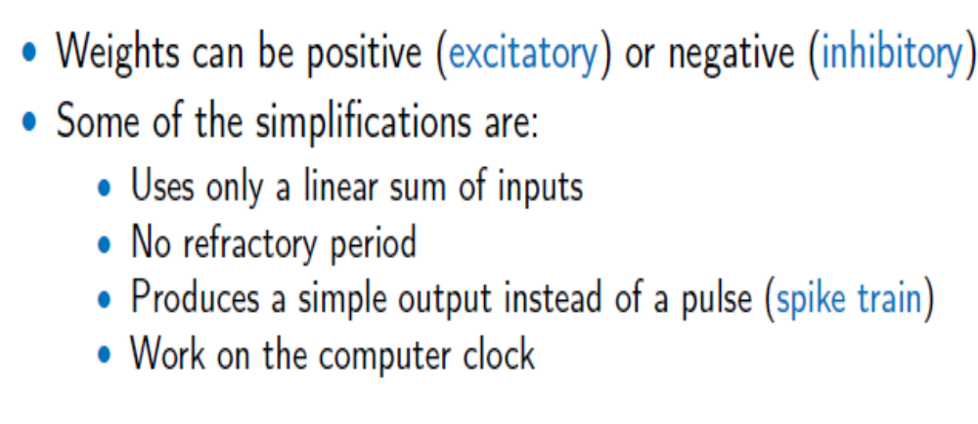
First Artificial Neuron: McCulloch-Pitts Neuron

Slide 19
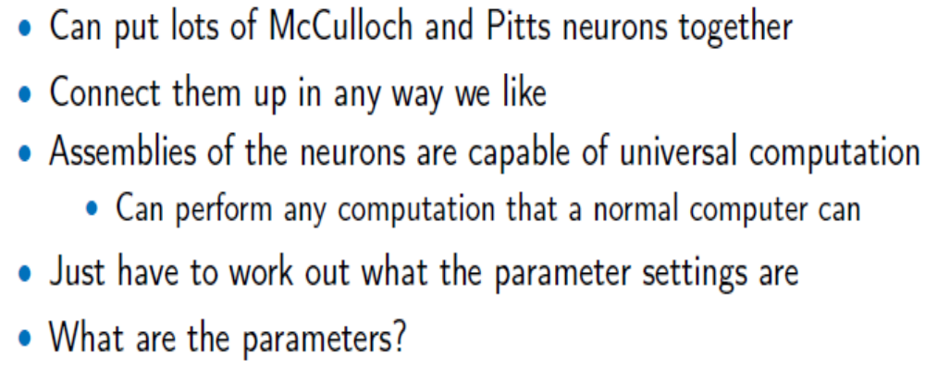
Neural Networks
A Single Neuron Cannot Do Much!

Slide 20
Neural Computation - Perceptron
Network of McCollough and Pitts neurons (Perceptron) can compute logical functions and be used to construct finite-state machines.
Can be used to simulate logic gates:
  AND: Let all w_{ji} be T_{j}/n, where n is the number of inputs.
  OR: Let all w_{ji} be T_{j}
  NOT: Let threshold be 0, single input with a negative weight.
Can build arbitrary logic circuits, sequential machines, and computers with such gates.
Given negated inputs, two layer network can compute any boolean function using a two level AND-OR network.

Slide 21
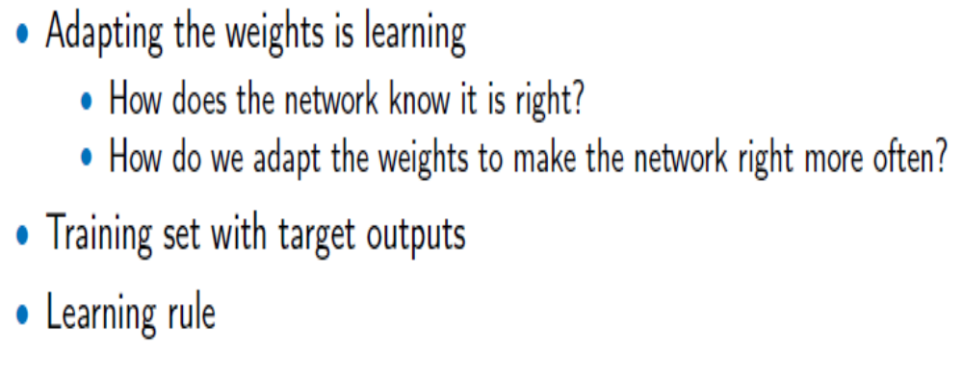
Training Neural Networks

Slide 22
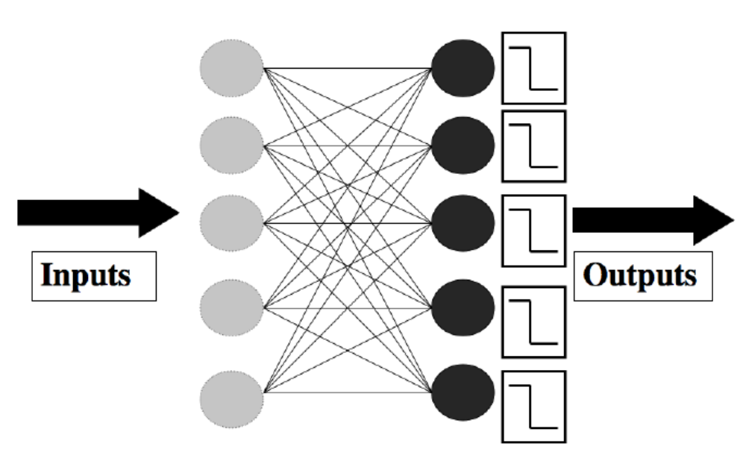
The Perceptron

Slide 23
Perceptron Training
Assume supervised training examples giving the desired output for a unit given a set of known input activations.
Learn synaptic weights so that unit produces the correct output for each example.
Perceptron uses iterative update algorithm to learn a correct set of weights.

Slide 24
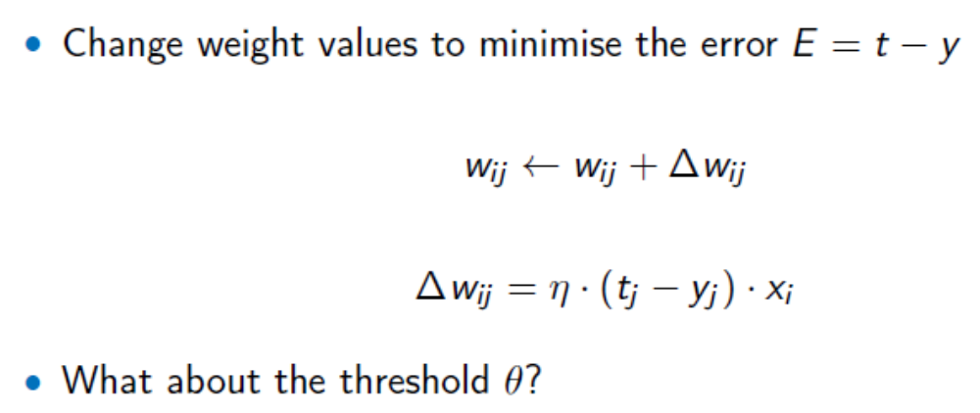
Perceptron Training
t is the target and y is the actual output

Slide 25
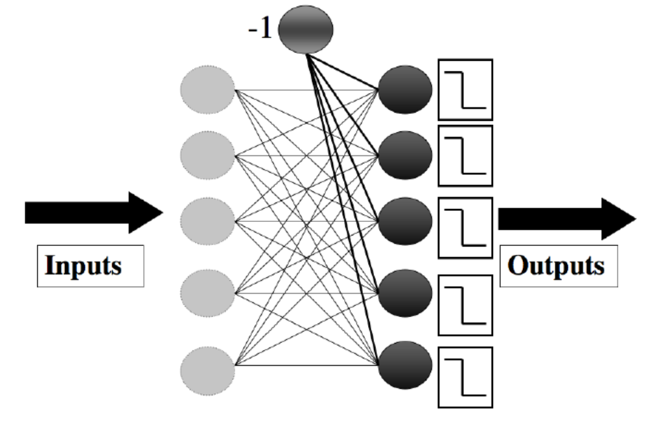
Handling Biases
To learn biases, use a set of additional weights

Slide 26
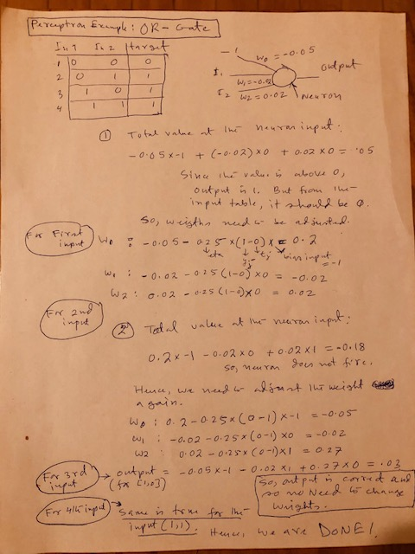
Some examples (OR Gate)

Slide 27
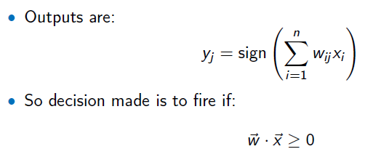
Recall Phase

Slide 28
Some examples
To be done in the class

Slide 29
Perceptron Learning Algorithm
Iteratively update weights until convergence.
Each execution of the outer loop is typically called an epoch.
Initialize weights to random values
Until outputs of all training examples are correct
For each training pair, E, do:
Compute current output o_{j} for E given its inputs
Compare current output to target value, t_{j ,} for E
Update synaptic weights and threshold using learning rule

Slide 30
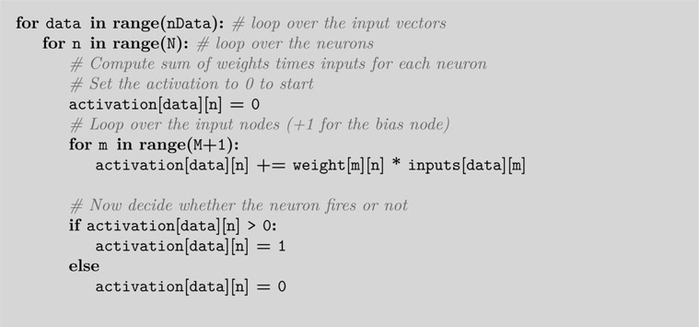
Perceptron Learning Algorithm
Pseudo Code (Recall) Using Python

Slide 31
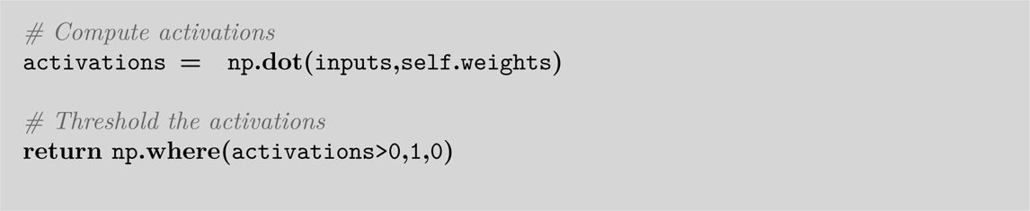
Perceptron Code Simplified with Matrix Multiplication using Python
Forward Pass / Recall
Training
Adding for Bias

Slide 32
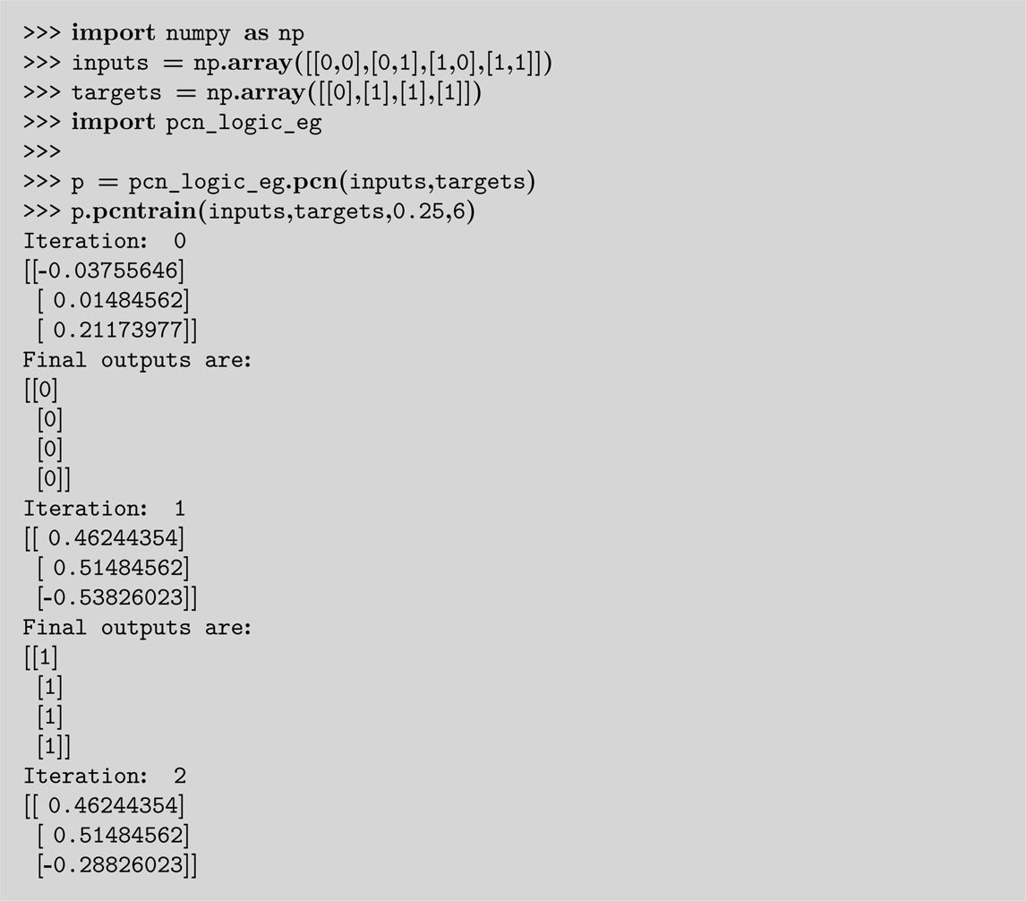
Running Python – From File - 2

Slide 33
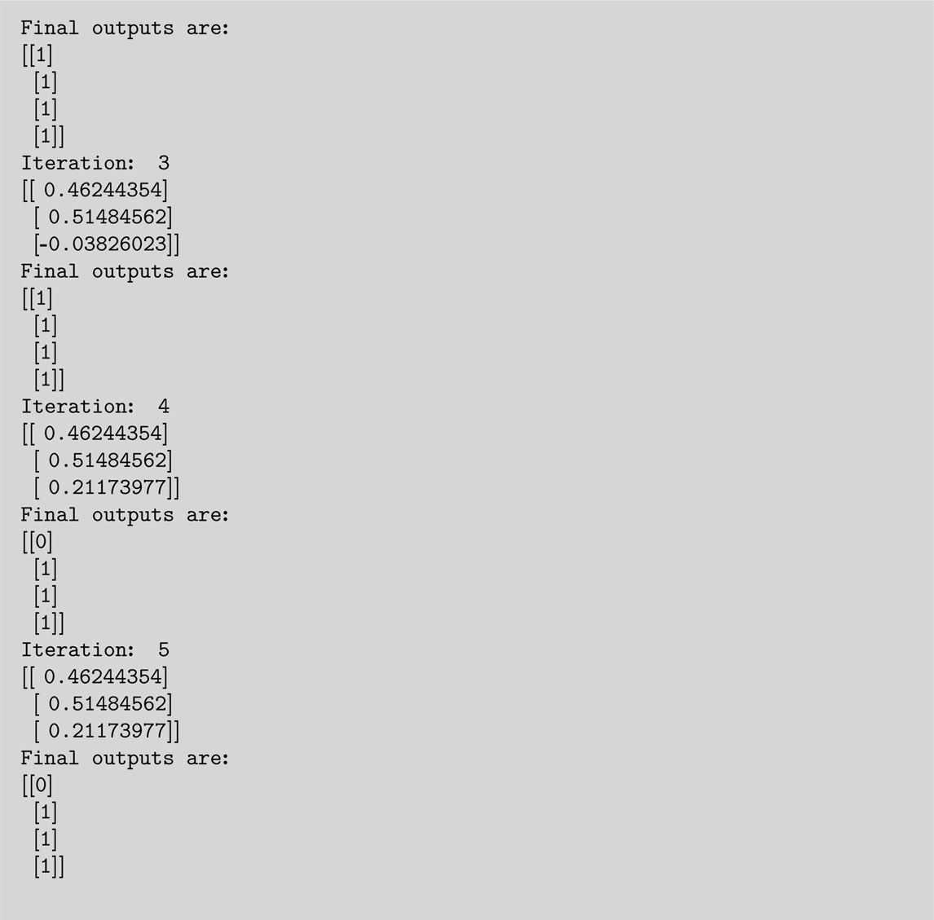
Running Python – From File -1

Slide 34
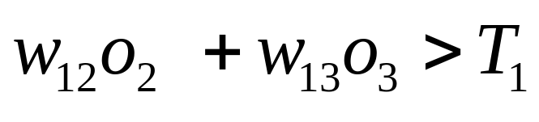
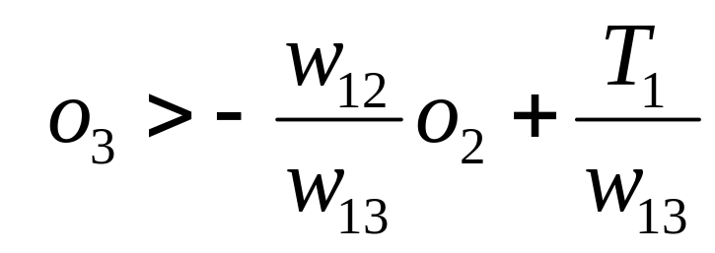
Perceptron as a Linear Separator
Since perceptron uses linear threshold function, it is searching for a linear separator that discriminates the classes.
o₃
??
Or hyperplane in
n-dimensional space
o₂

Slide 35
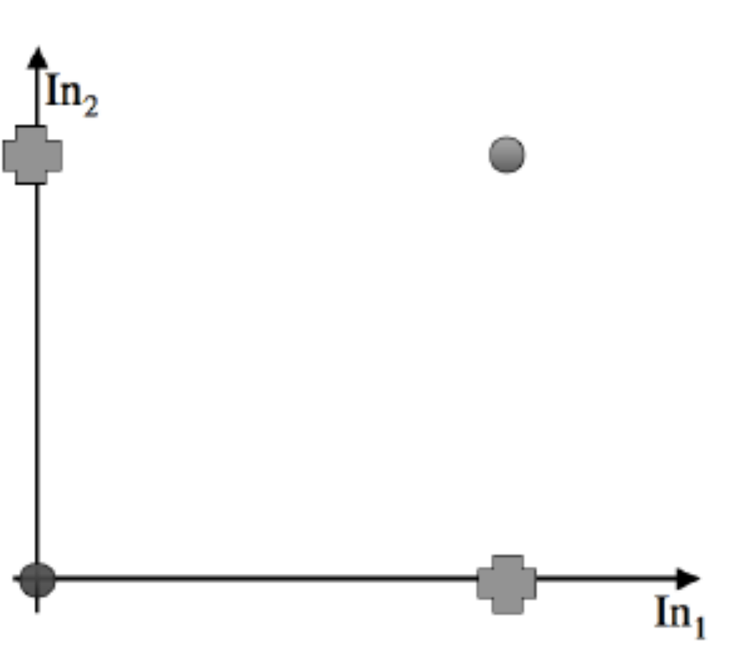
Perceptron as a Linear Separator

Slide 36
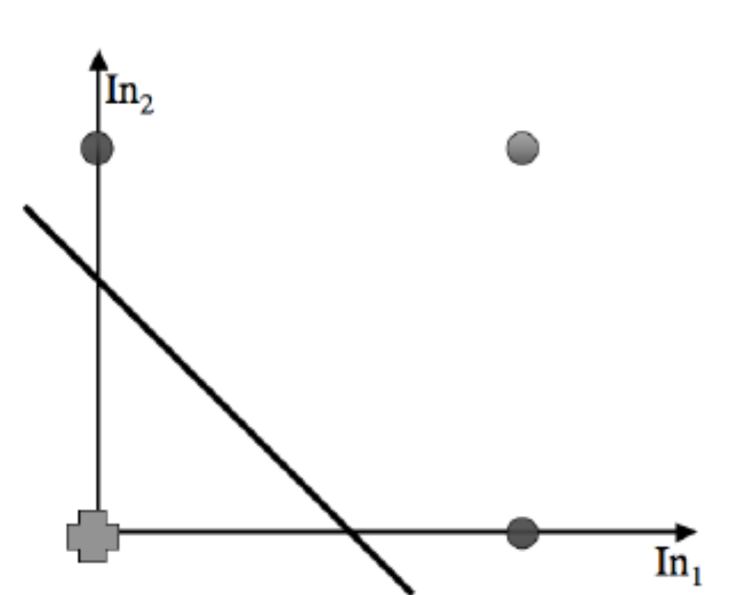
Perceptron as a Linear Separator

Slide 37
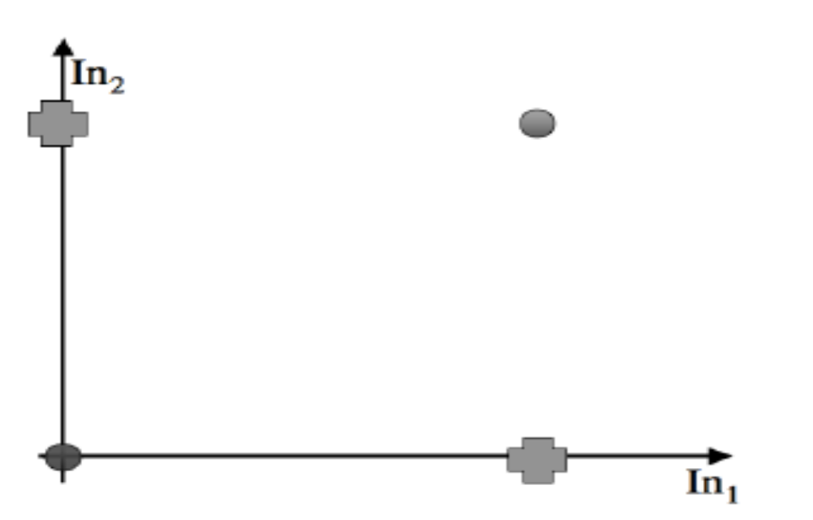
Concept Perceptron Cannot Learn -1
Cannot learn exclusive-or, or parity function in general.

Slide 38
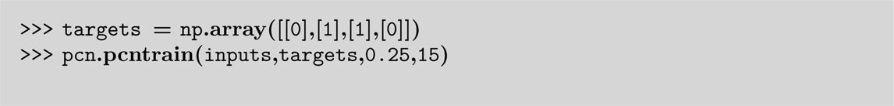
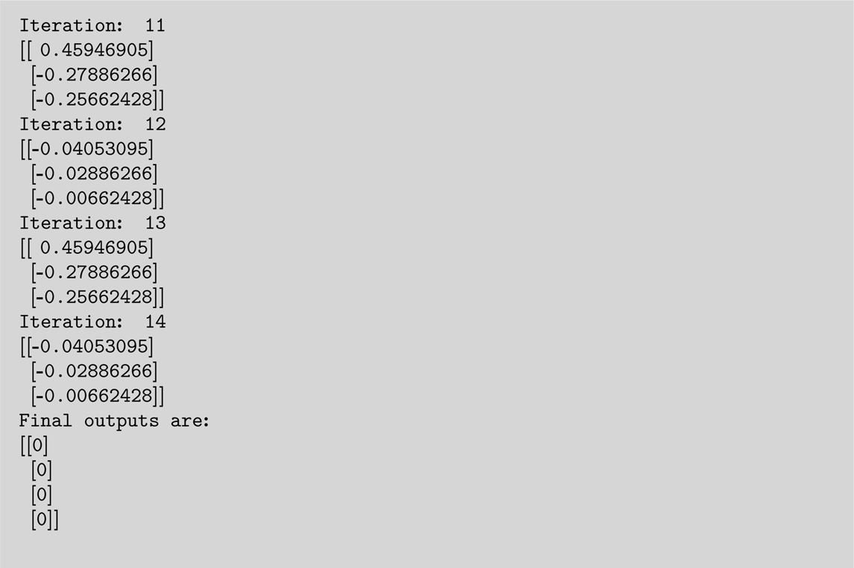
Concept Perceptron Cannot Learn -2

Slide 39
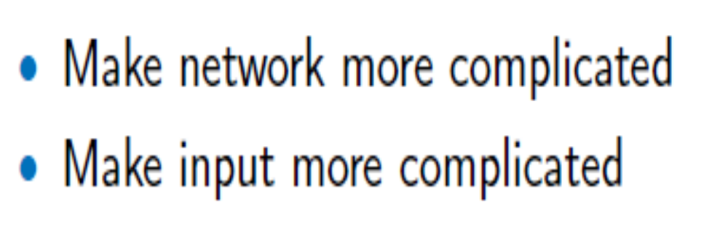
Two Solutions

Slide 40
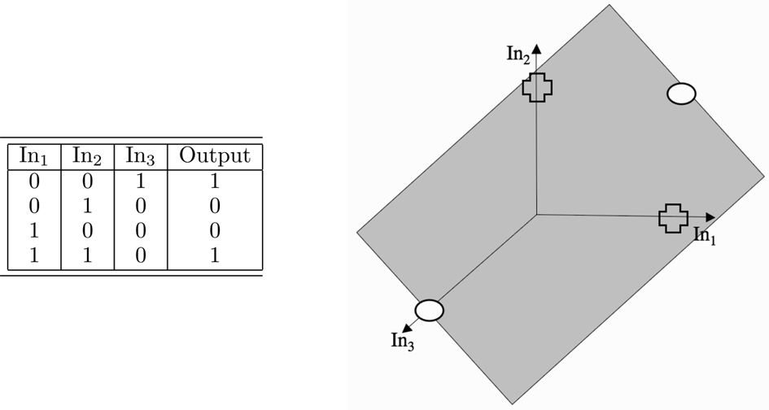
Make Input More Complicated
FIGURE 3.10 A decision boundary (the shaded plane) solving the XOR problem in 3D with the crosses below the surface and the circles above it.

Slide 41
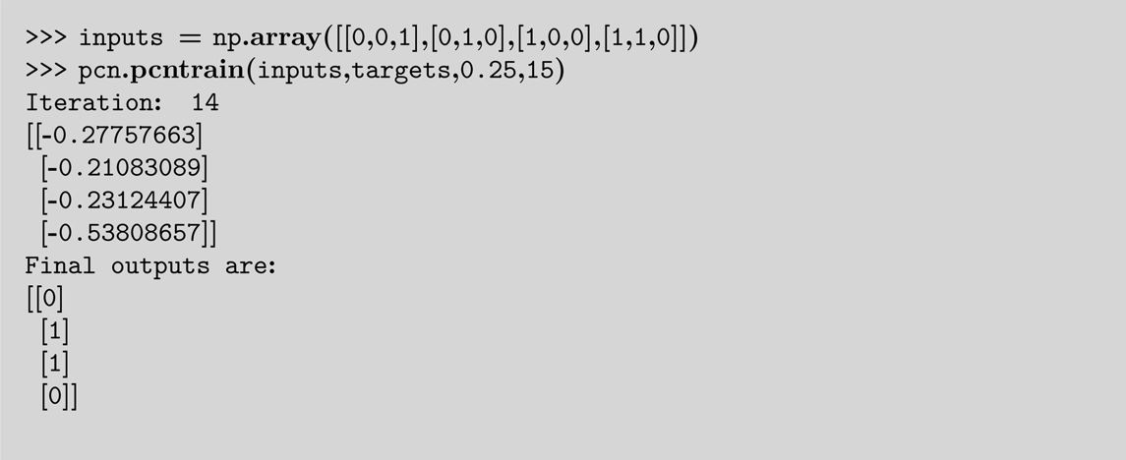
Input More Complicated – Results (Perceptron Solves XOR Prob)

Slide 42
Perceptron Limits
System obviously cannot learn concepts it cannot represent.
Minksy and Papert (1969) wrote a book analyzing the perceptron and demonstrating many functions it could not learn.
These results discouraged further research on neural nets; and symbolic AI became the dominate paradigm.

Slide 43
Perceptron Convergence and Cycling Theorems
Perceptron convergence theorem: If the data is linearly separable and therefore a set of weights exist that are consistent with the data, then the Perceptron algorithm will eventually converge to a consistent set of weights.
Perceptron cycling theorem: If the data is not linearly separable, the Perceptron algorithm will eventually repeat a set of weights and threshold at the end of some epoch and therefore enter an infinite loop.
  By checking for repeated weights+threshold, one can guarantee termination with either a positive or negative result.

Slide 44
Perceptron Performance
Linear threshold functions are restrictive (high bias) but still reasonably expressive; more general than:
  Pure conjunctive
  Pure disjunctive
  M-of-N (at least M of a specified set of N features must be present)
In practice, converges fairly quickly for linearly separable data.
Can effectively use even incompletely converged results when only a few outliers are misclassified.
Experimentally, Perceptron does quite well on many benchmark data sets.

